Slide 1

COMP8270 / PROGRAMMING FOR ARTIFICIAL INTELLIGENCE
The UK’s European university

Slide 2
overview:
Verify our trained model.
Cross Validation
Using Keras simplify our workflow
Jupyter

Slide 3
Review
We have seen two important types of feed-forward ANNs.
Regression
Classification
The model life-cycles consists of:
Training
Inference (using our training model in our application)
Before we deploy our trained model can we be sure that we “believe” it?

Slide 4
Fitting the Model
When training, the system uses a loss metric.
Regression: mean squared error (MSE)
Classification: cross entropy loss
We can also monitor accuracy: Correct/Examples
Suppose the training yielded a loss 0.00001 and accuracy of 100% - are we done?

Slide 5

Over Fitting
We could quickly train an ANN to learn this.
Why is it a bad idea?
Intuitively we know this is wrong.

Slide 6
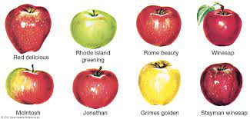
Increase the Number of Examples
This is much better.
More examples yields more information.

Slide 7
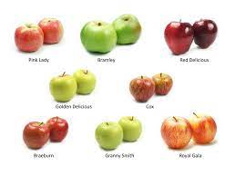
Beware of 100% Accuracy
The more the better!
The loss and accuracy are good indicators, but they do not tell us if we have over fitted our model.

Slide 8
Validation
It is important to expose our trained model to data that it has never seen before.
Data that it was not trained with.
Prior to training we divide our data in to two sets: training and validation.
The model is trained with the training set
We then validate with the validation set (use the trained model for inference).
If the model is not over fitted we should observe good results.

Slide 9
Workflow
Pre-process our data
Divide the data in to training and validation
Train the model with the training data
Validate the model with the validation data
If we are unhappy return to Step 3

